Slide 1


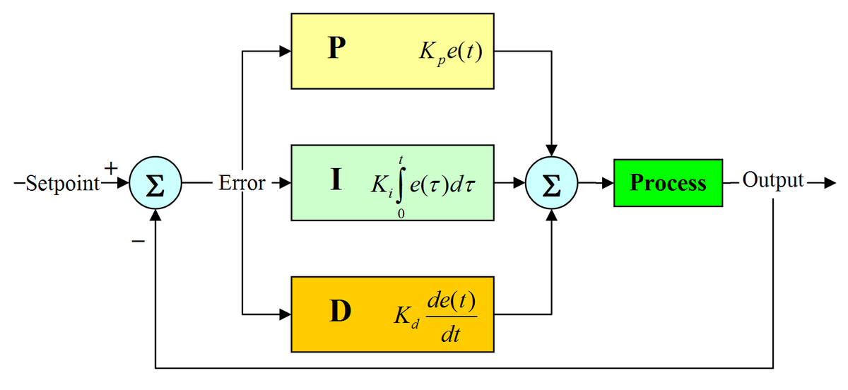
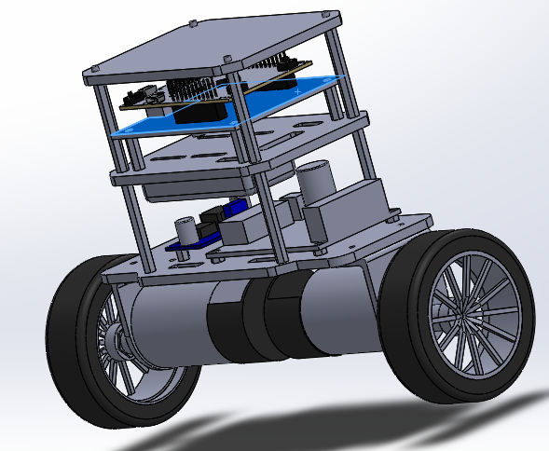
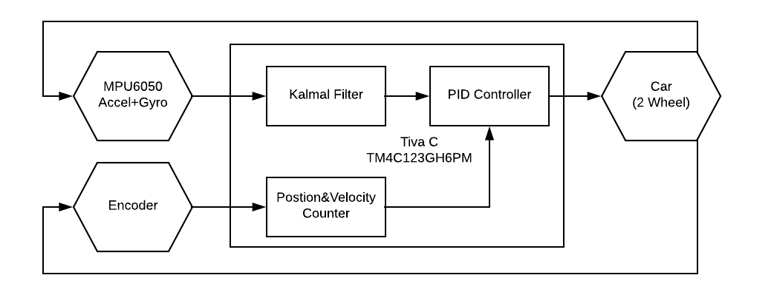
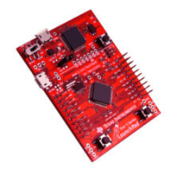
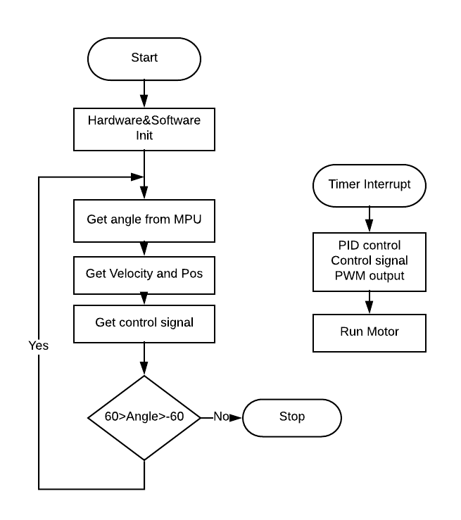
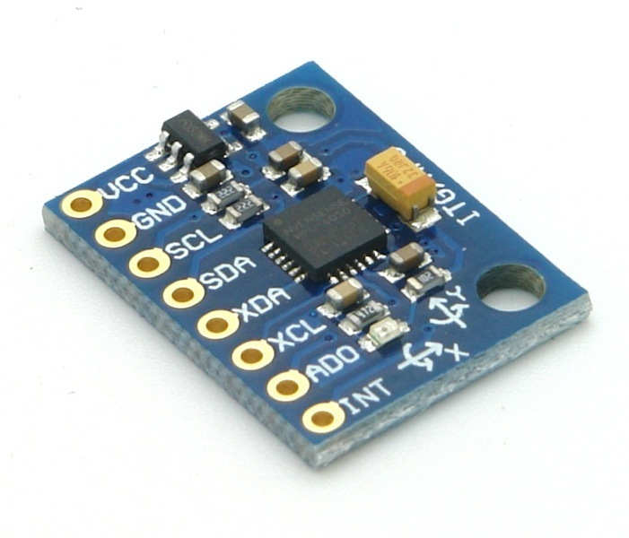
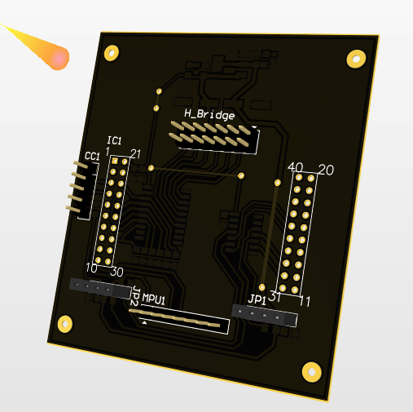
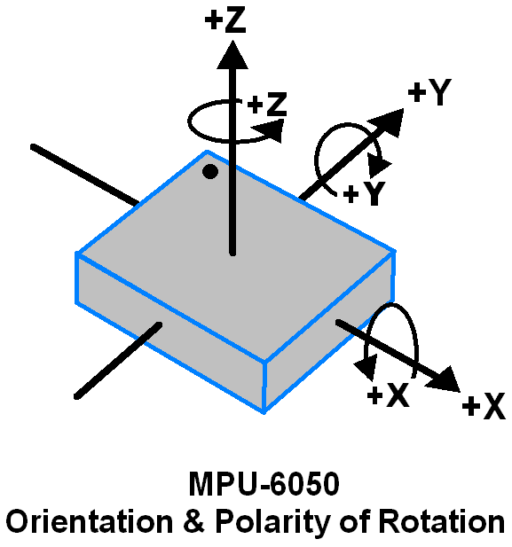
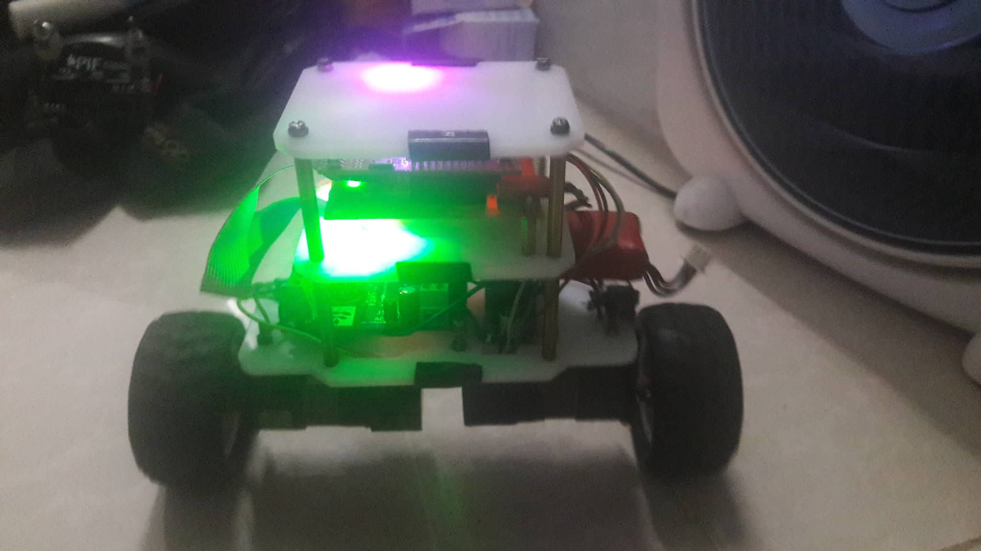
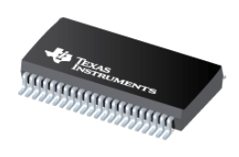
Self-Balancing Robot
Tam Nguyen-Thanh
INTRODUCTION
This paper presents a two-wheel self-balancing robot based on Tiva C TM4C123G using Kalman filter to estimate angle from accelerometer and gyroscope. PID algorithm to control angle, position and velocity.
HARDWARE DESIGN
Mechanical: Robots are designed to have its center as low as possible and divided into layers to protect electronic components. The frame should be compact and hard using SolidWork to design.
Fig. 6. The block diagram of PID controller
SYSTEM OVERVIEW
TM4C123G is Cortex-M4 32bit based on ARM architecture including Tiva C launchpad as MCU of the system. Thanks to TivaWare, programming for MCU is made easier.
Figure 7. System block diagram.
Figure 1. Tiva C Launchpad.
Figure 4. 3D view of the robot on SolidWork 2018
The MPU-6050 is integrated with 6-axis
MotionTracking device that combines a 3
axis gyroscope, 3-axis accelerometer, and
DMP all in a small 4x4x0.9mm package.
The angle is calculated from the parameters
taken from the sensor.
Mainboard: where the Tiva C Launchpad, MPU 6050 and other electronic parts are located.
Figure 7. Flow algorithm
RESULTS AND CONCLUSION
Figure. 2. MPU 6050.
Figure 5. 3D view mainboard on Altium 18
For driving motors, DRV8412 Dual Full-Bridge PWM Motor Driver is used. Driver have PWM Operating Frequency up to 500 kH. H-Bridge MOSFETs and an intelligent gate drive design, so the efficiency of
these motor drivers can be up to 97%.
CONTROL SYSTEM
A proportional–integral–derivative controller (PID controller or three-term controller) is a control loop feedback mechanism widely used in industrial control systems and a variety of other applications requiring continuously modulated control. A PID controller continuously calculates an error value e(t) as the difference between a desired setpoint (SP) and a measured process variable (PV) and applies a correction based on proportional, integral, and derivative terms.
Figure 9. Photo of the complete robot
The robot can stand up firmly and stably after calibrating system parameters and its speed and location can be controlled wirelessly.
Development direction: use LQR in replacement of out-dated and flawed PID.
Figure. 3. DRV 84x2
The 2019 PIF 9th Anniversary. January 4th, 2019, Ho Chi Minh City.

